Slide 1
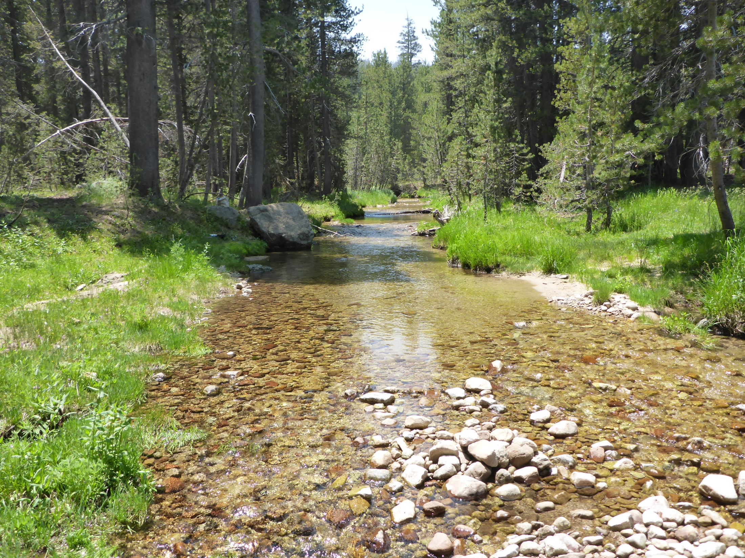
Budd Creek
Between Culvert and Side Channel

Slide 2

Looking upstream
Tape Down
Boulder (RR)

Slide 3
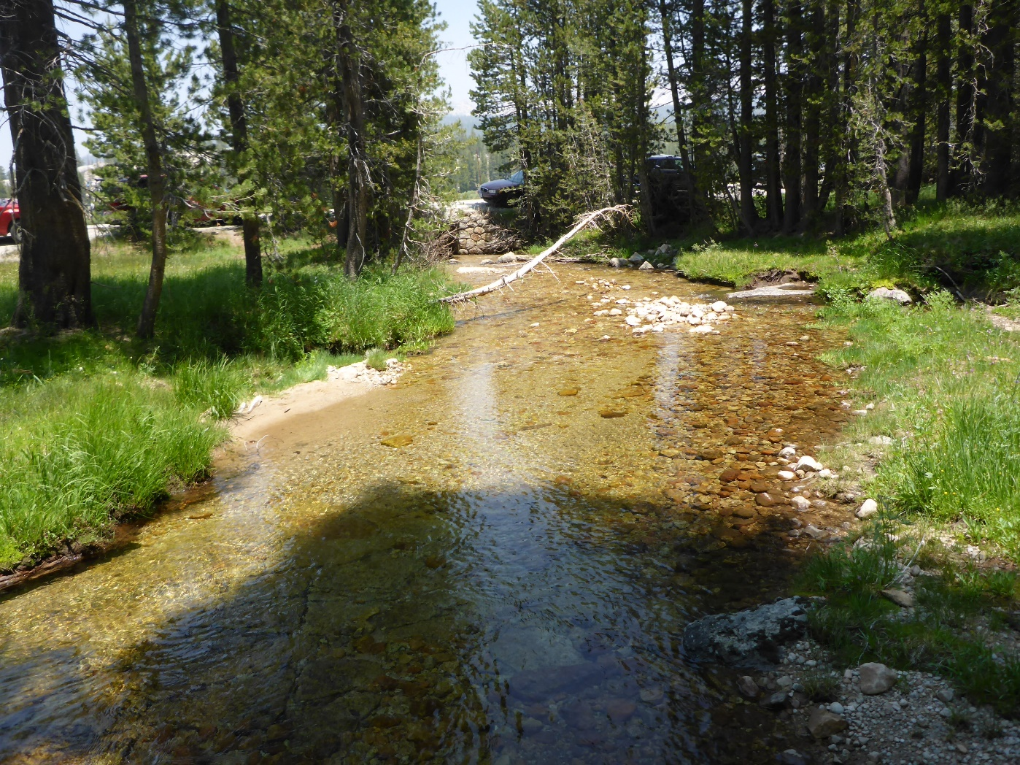
From TD Boulder looking downstream
Hwy 120

Slide 4
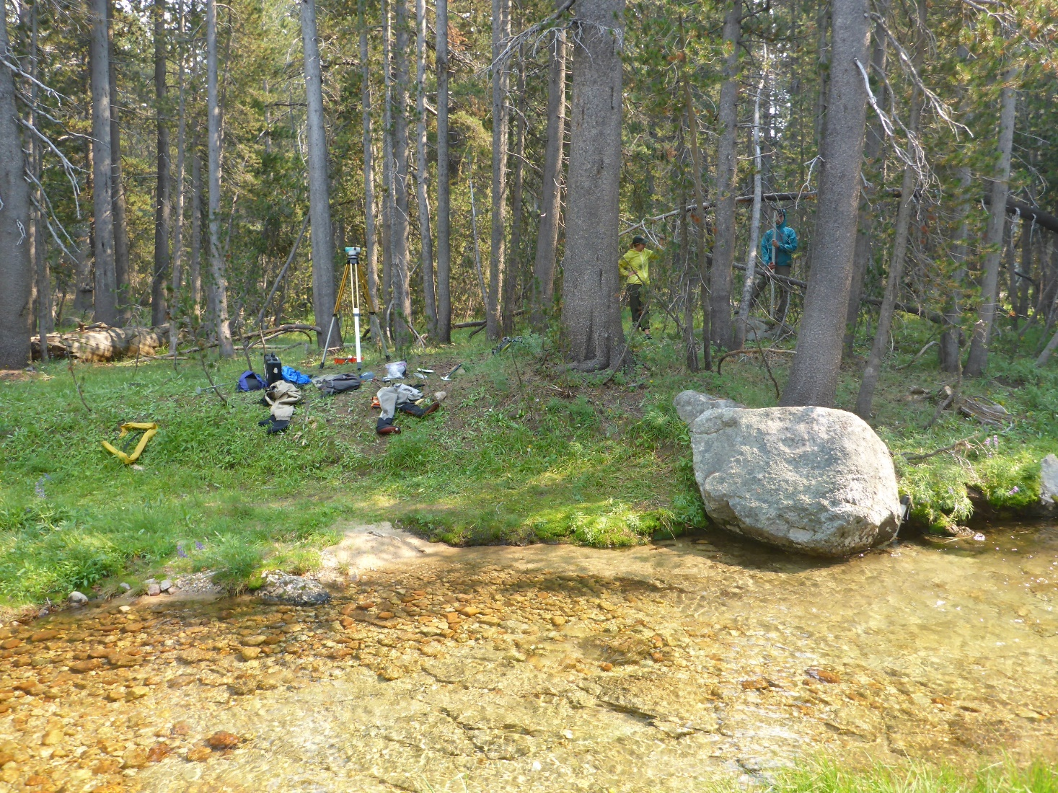
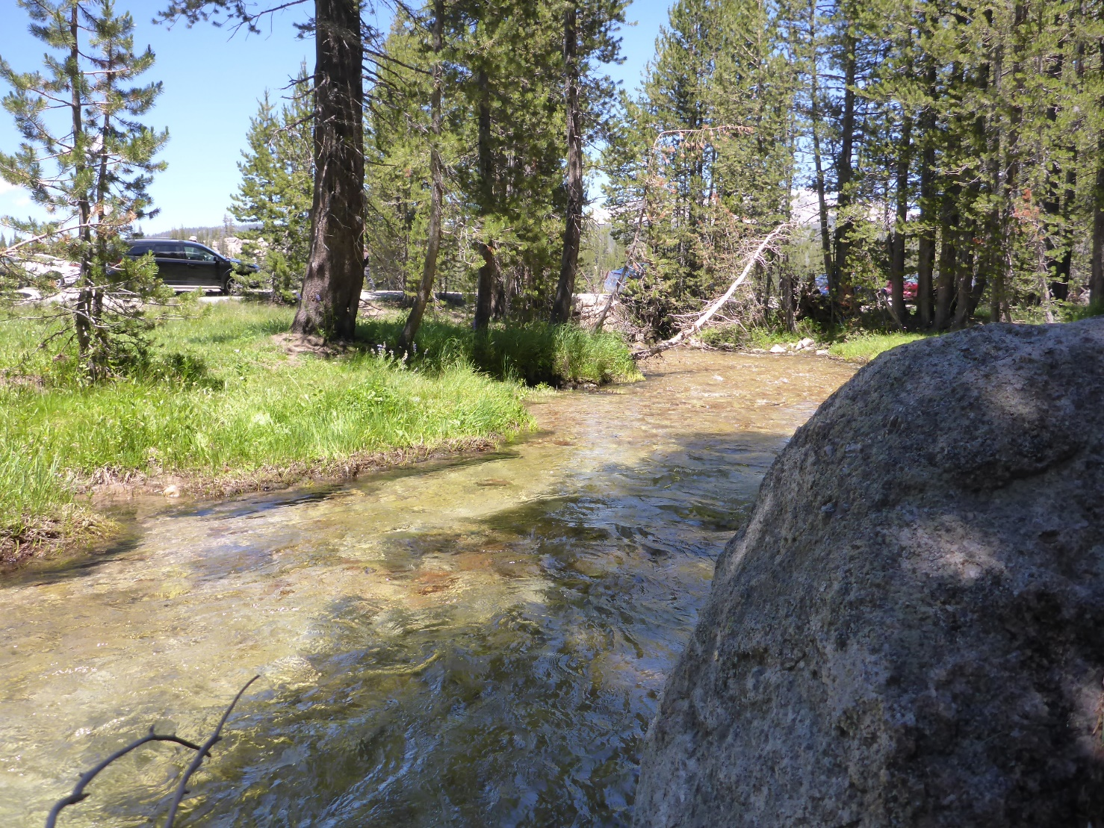
Tape Down Boulder
Road for reference
TD Boulder (RR)

Slide 5
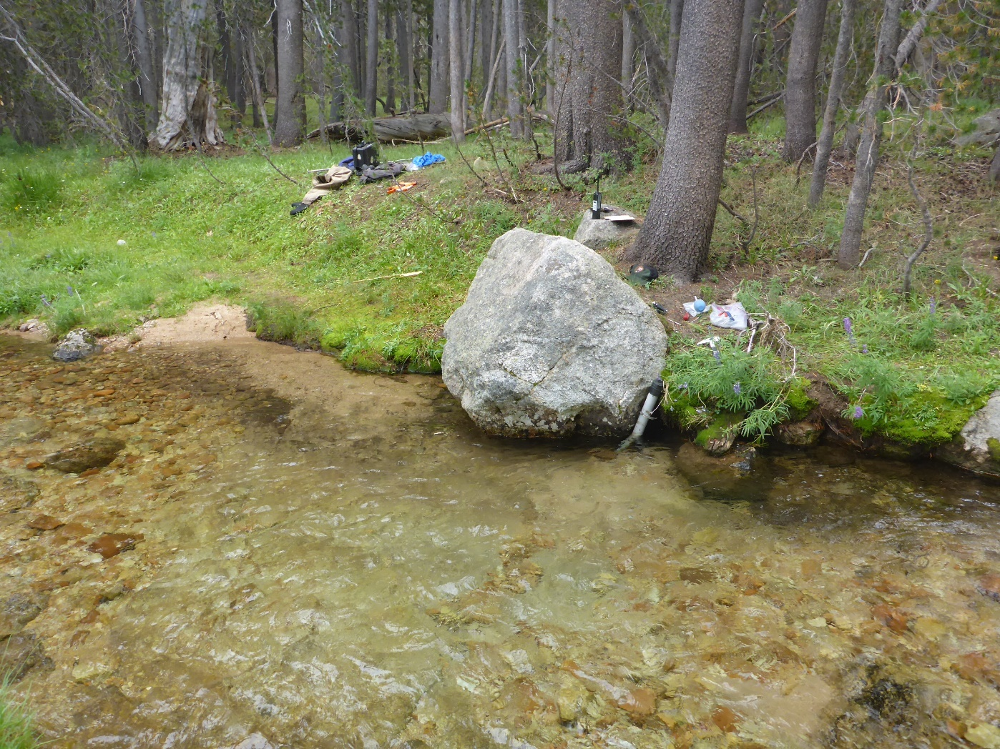
Tape Down Boulder and Stilling Tube

Slide 6
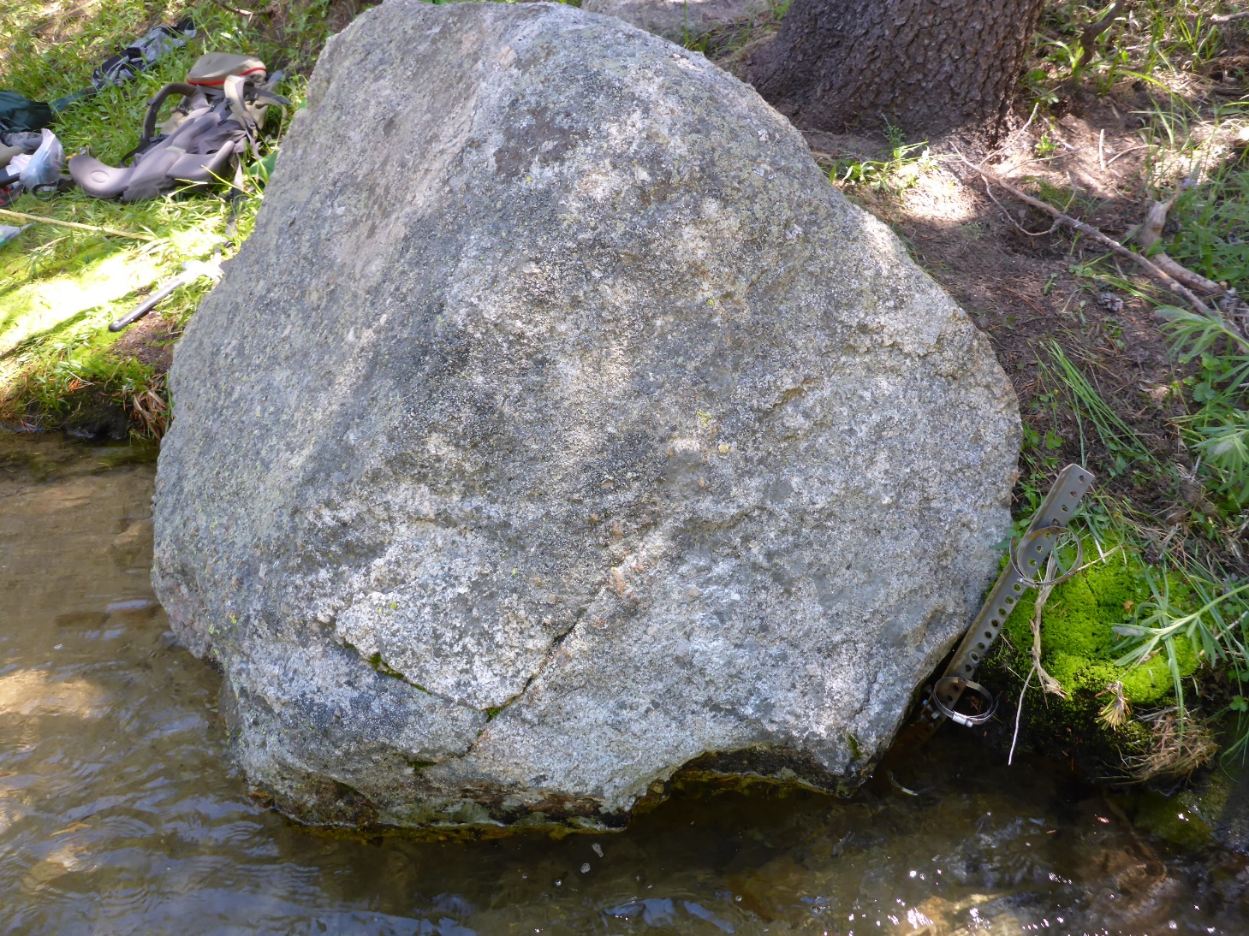
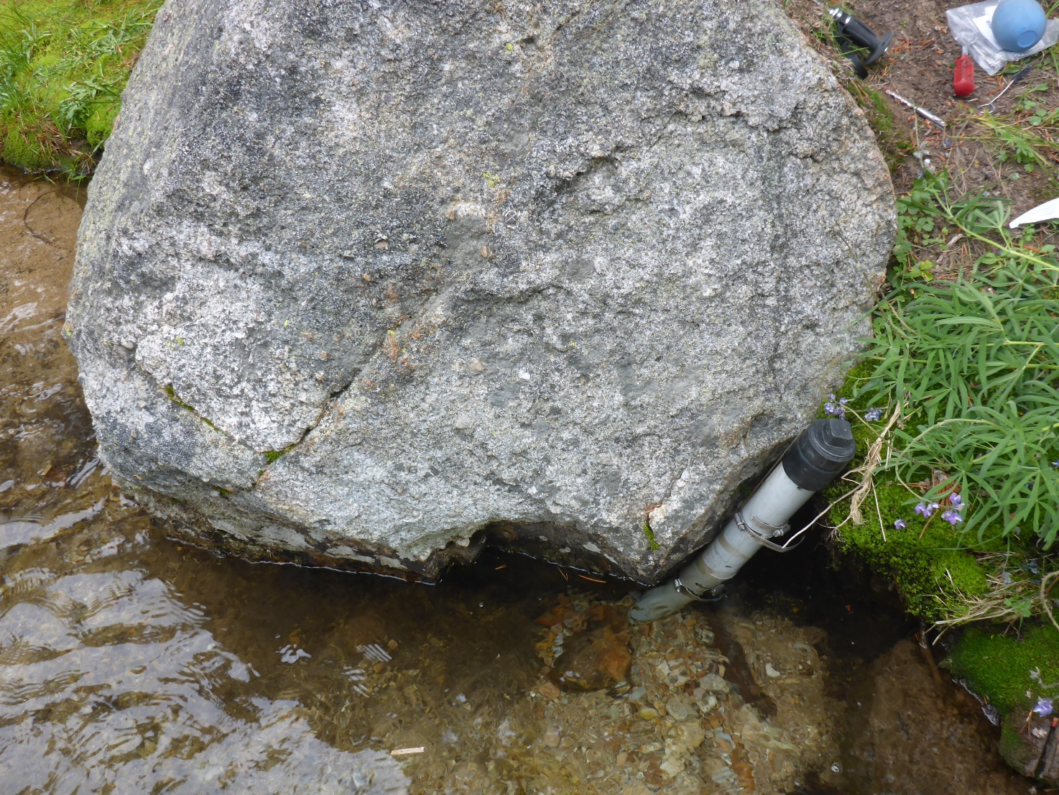
Stilling Tube
Tape Down Bolt

Slide 7
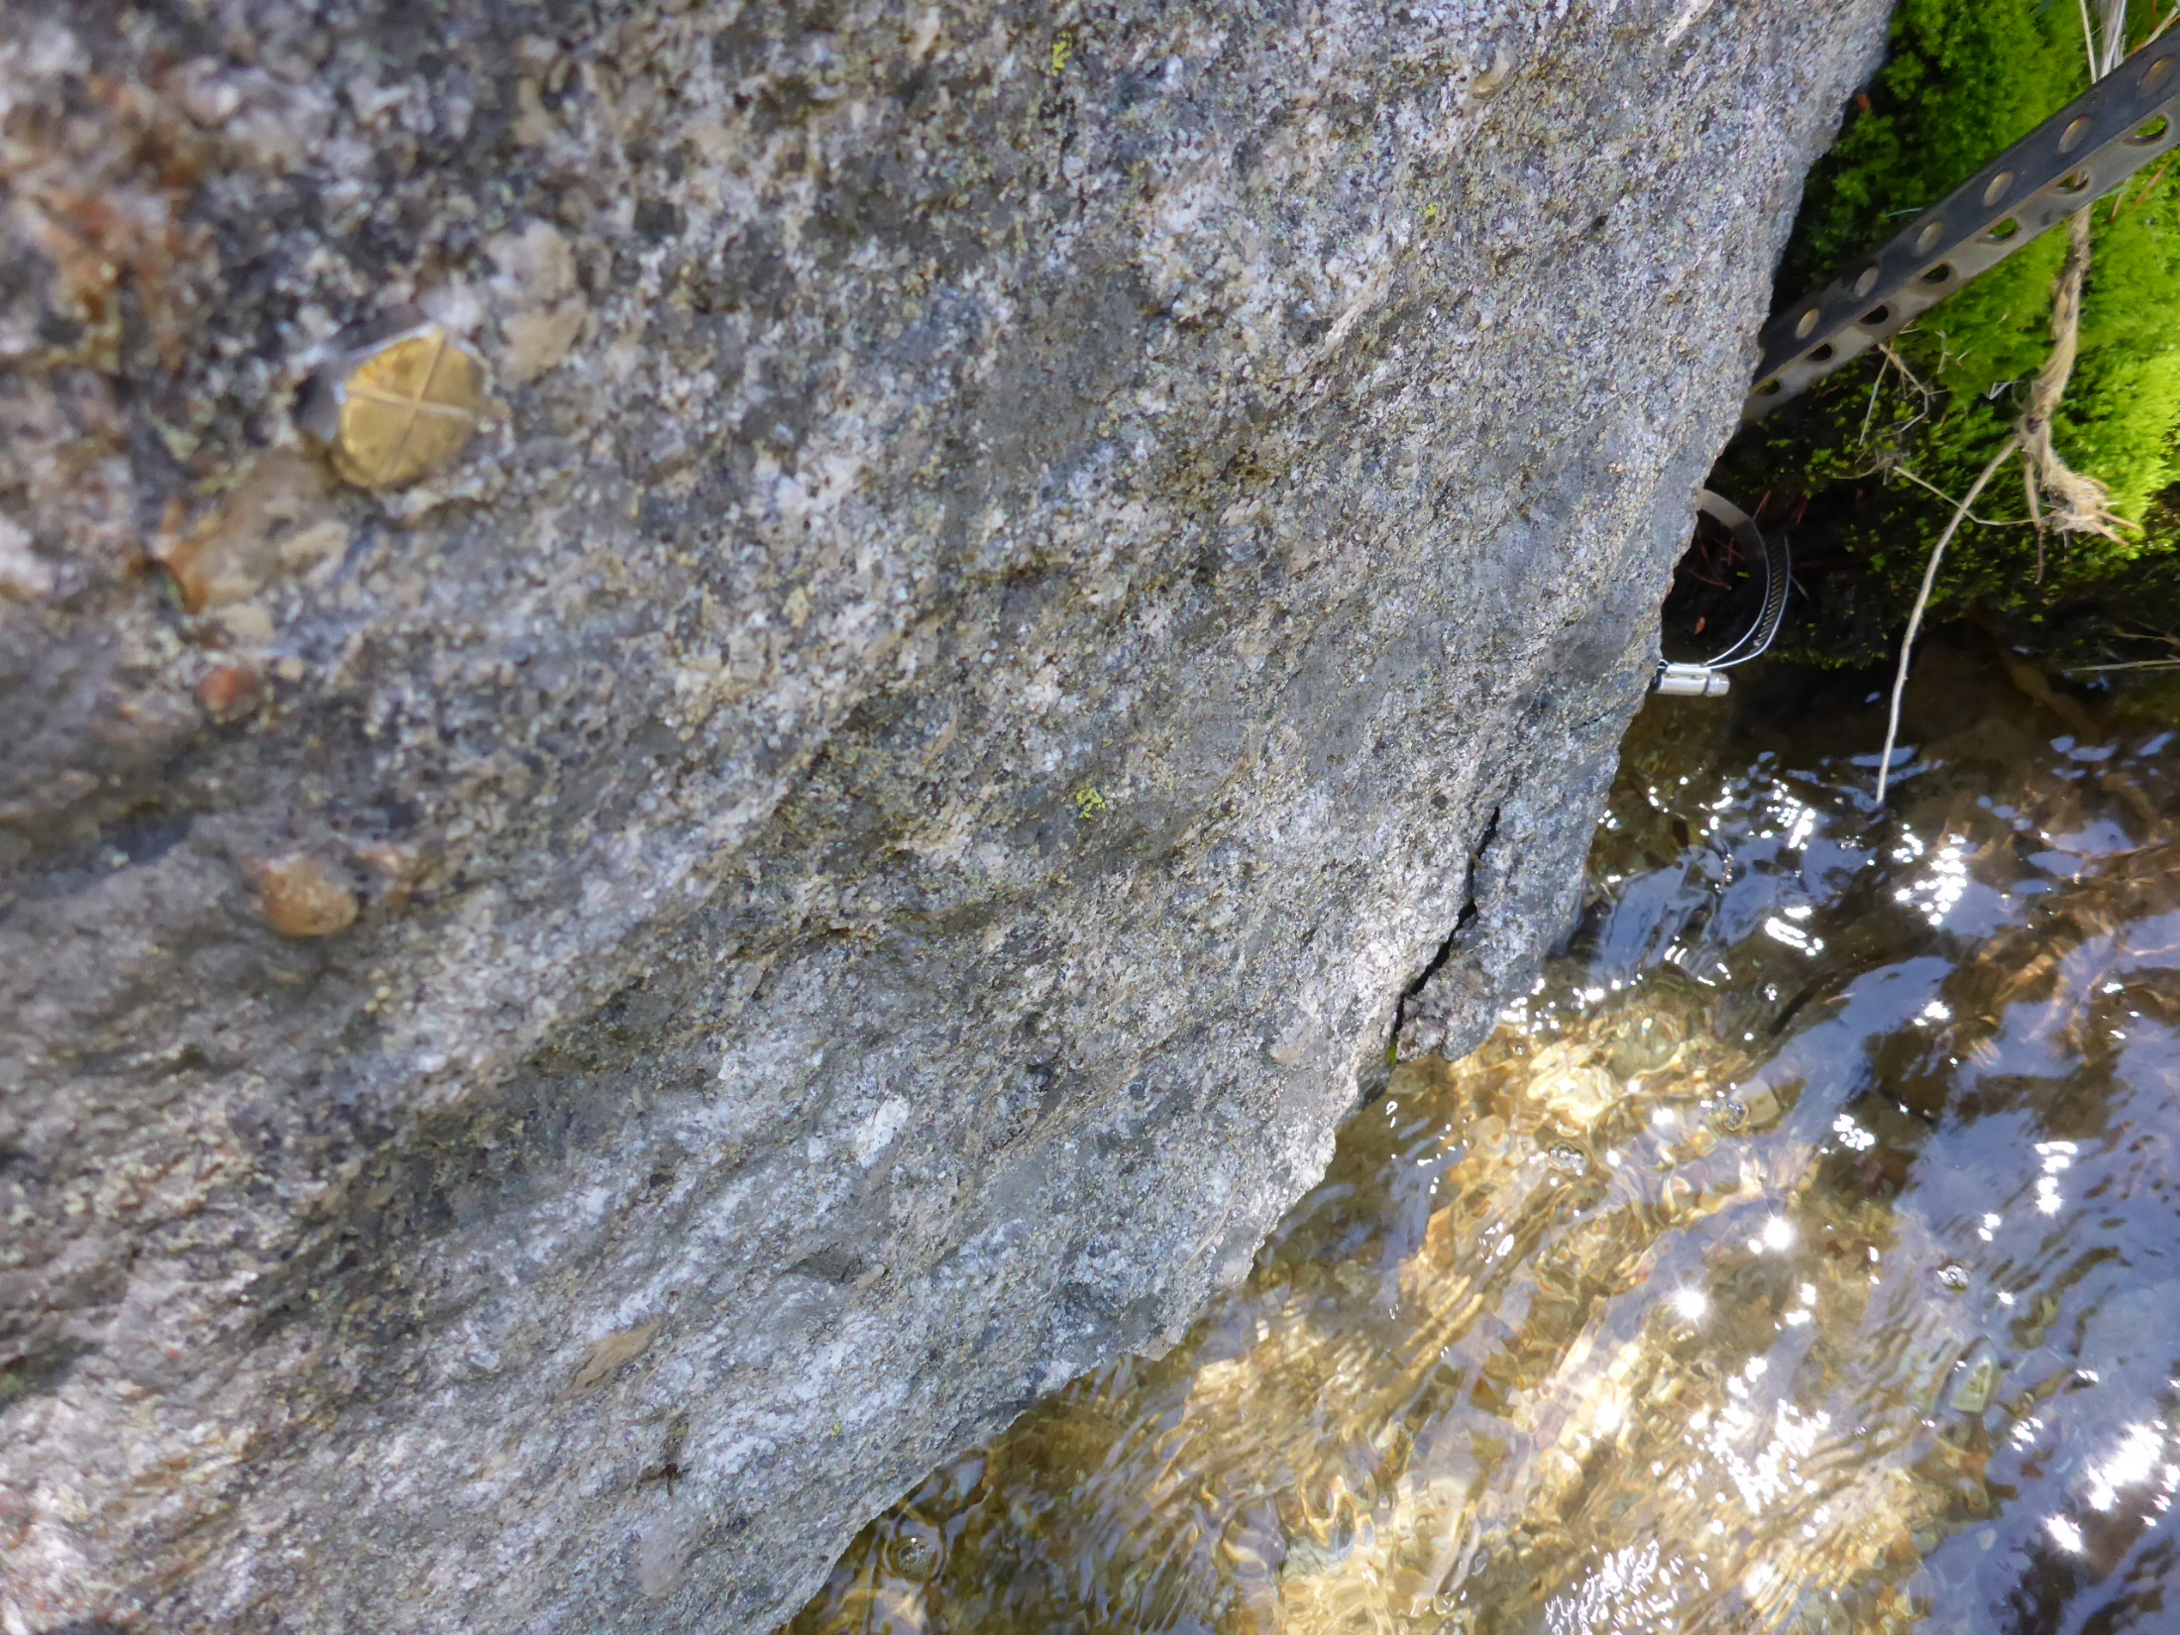
Stilling
Tube
installation
Tape Down
Bolt

Slide 8
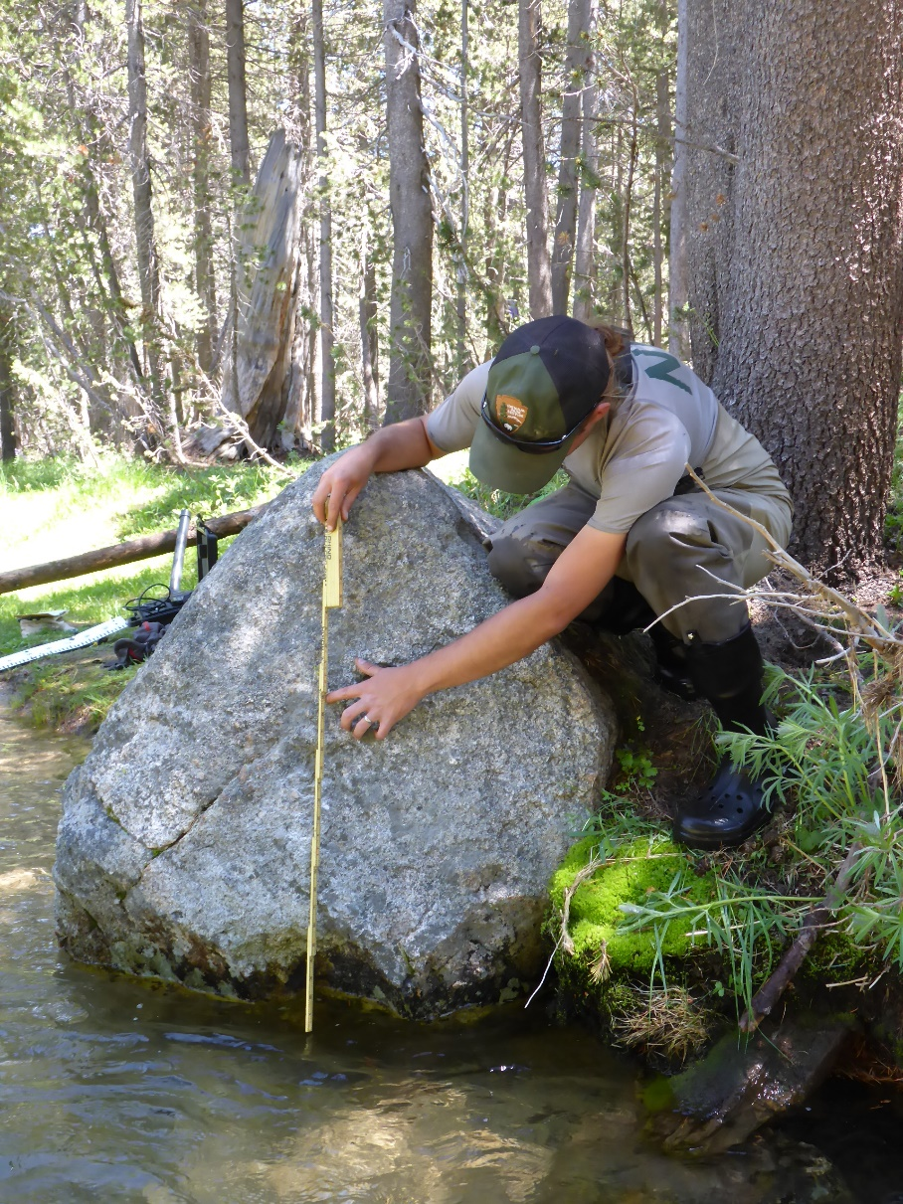
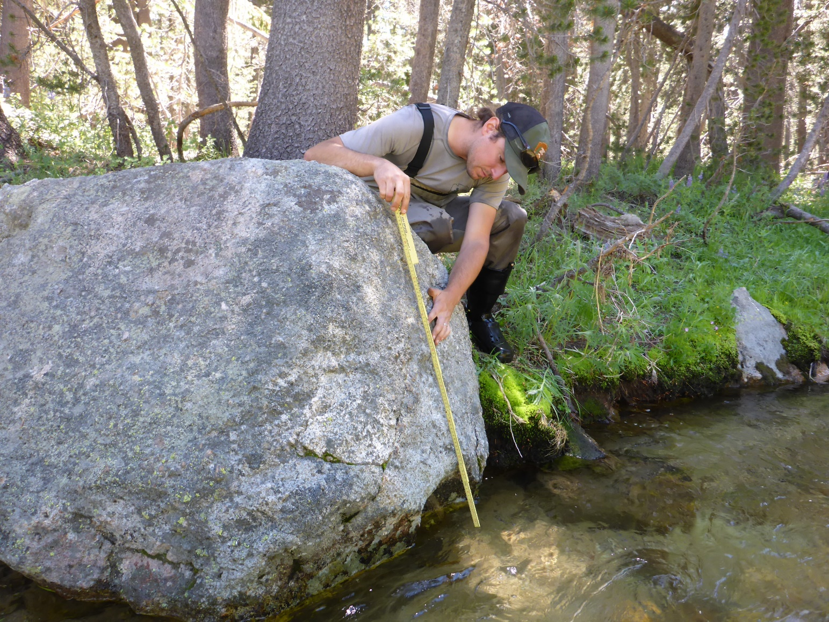
Tape Down Method –
Engineer’s ruler flush with boulder, measure from X
Tape down bolt
Tape
Down
Bolt

Slide 9
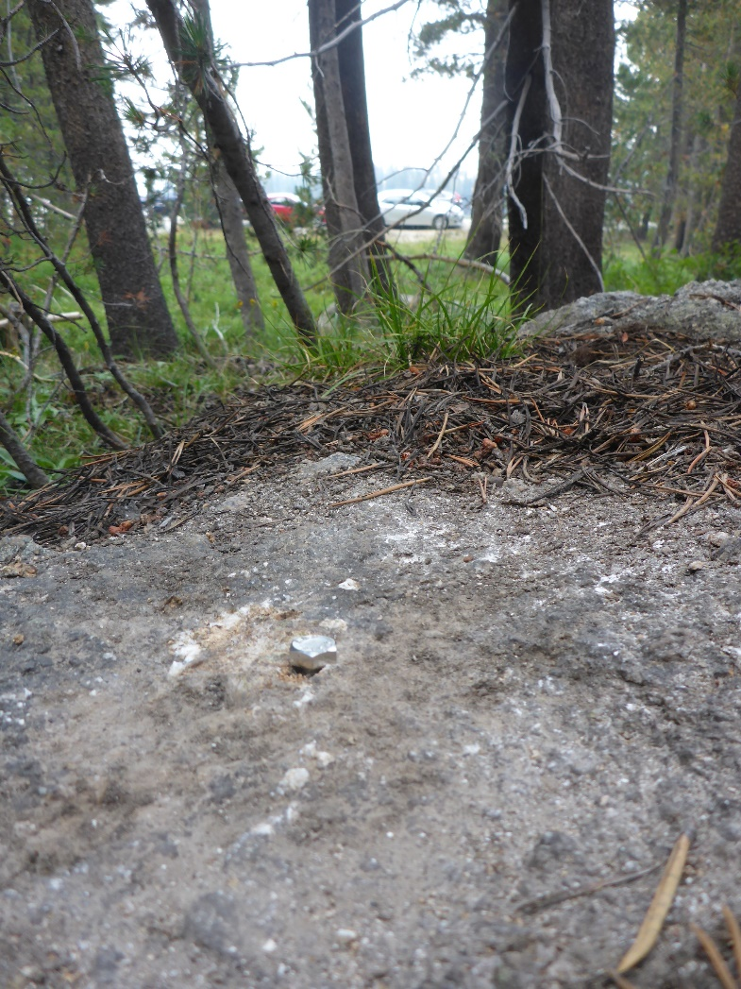
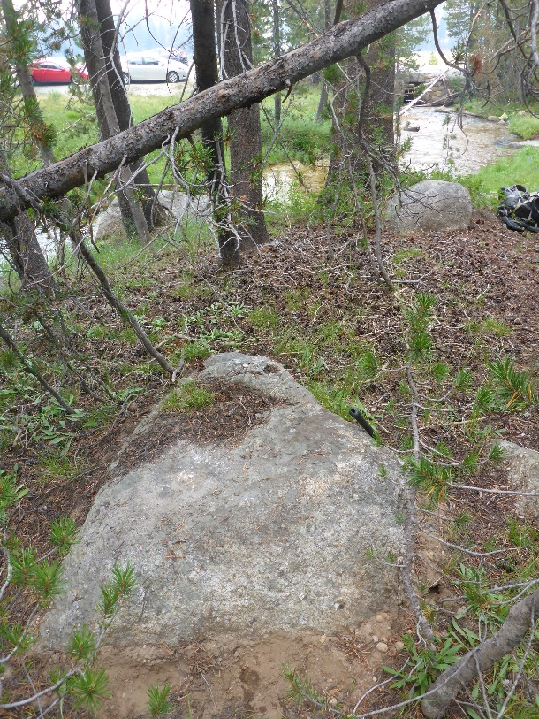
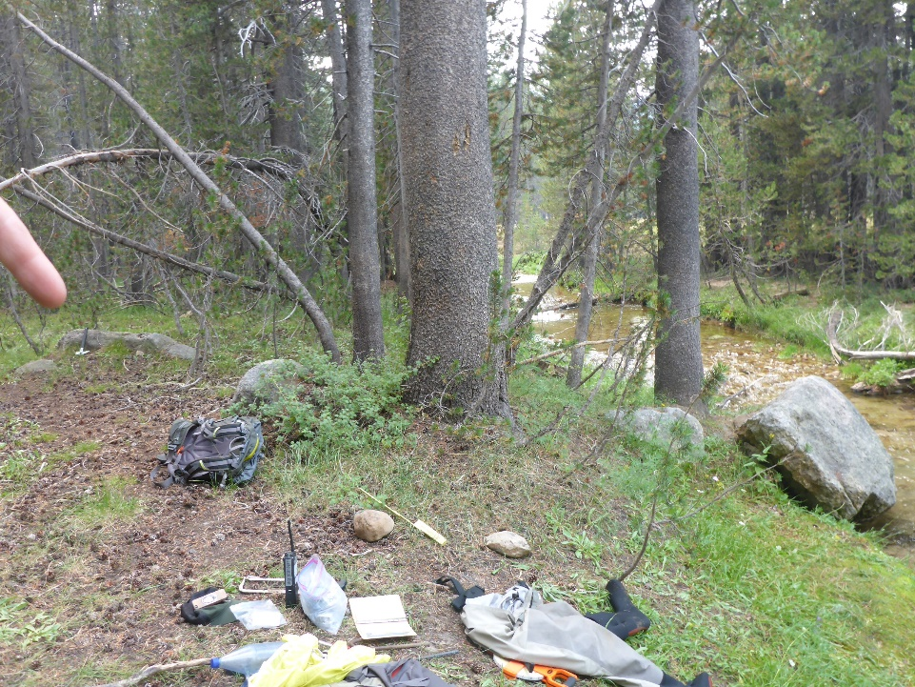
Benchmarks
Benchmark Bolt
Benchmark Rock

